Slide 1



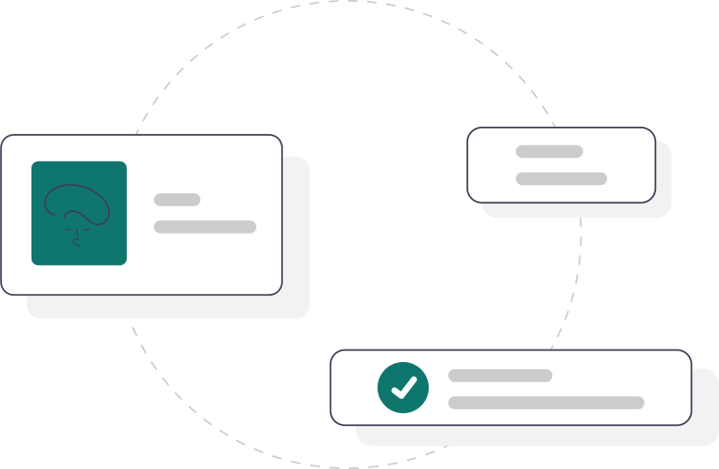
Part A System overview
NIC says
We propose
ServicePlus functional overview
The proposed platform connects service design, application processing and government support functions.
Users
Access channels
Configured services
Government partners
Citizens and government staff initiate or manage service requests.
People use public pages, assisted centres or officer screens.
Approved forms and workflows govern application review and decisions.
Approved exchanges support verification, payment and document delivery.
Identity and organisation
Service definition
Application runtime
Outputs and money
Platform management
NIC says: sources 7–20. We propose the overall arrangement.
1/19

Slide 2





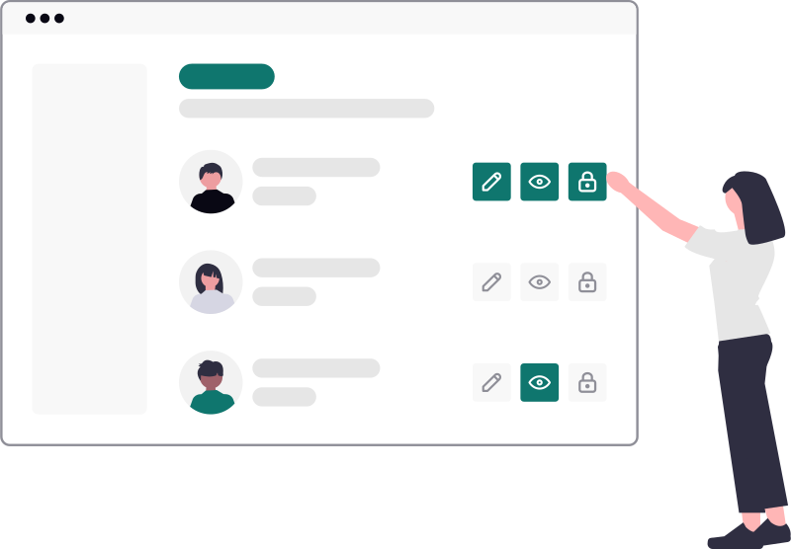
Part A Participants
NIC says
We propose
People and operational responsibilities
Citizen
Assisted operator
Processing officer
The citizen applies, tracks progress and receives the official outcome.
The operator submits applications under the citizen’s recorded authority.
The officer reviews assigned cases and records authorised actions.
Role and office assignments determine each person’s permitted service access.
Department administrator
Service owner
Platform administrator
The administrator maintains offices, postings and permitted service access.
The owner defines policy and approves service configuration changes.
The administrator governs state onboarding and controlled platform support.
NIC says: sources 7,17,19. Expanded administrative roles: We propose.
2/19

Slide 3



Part A Service setup
NIC says
We propose
Service configuration and publication
Service owners prepare the service; departments approve operational readiness before launch.
Service definition
Service configuration
Acceptance testing
Release approval
Operational access
The service owner defines requirements, fees and approval responsibilities.
The owner prepares forms, processing steps, documents and messages.
The department tests normal cases and operational exceptions.
The authorised owner approves the service version for publication.
Administrators activate offices and assign authorised officers.
Failed acceptance tests return the configuration to its service owner.
NIC says: sources 5,8–13,19. We propose the approval sequence.
3/19

Slide 4
Part A Application journey
NIC says
We propose
Application submission through official delivery
The service definition determines the responsible office, required checks and authorised decision.
Preparation
Submission
Assignment
Decision
Delivery
The applicant completes the form and provides supporting documents.
The system validates the submission and provides an application reference.
The system routes the application to the responsible office.
The authorised officer records a decision with supporting reasons.
The applicant receives the certificate or a reasoned rejection.
Correction requests return to the applicant. Payment occurs at the stage required by service policy.
NIC says: sources 7,9,11,12. We propose the detailed sequence.
4/19

Slide 5

Part A Service types
NIC says
We propose
Three service paths with distinct outcomes
Internal processing
Submit application
Review and decide
Deliver official outcome
The platform manages review and the authorised decision.
Collection only
Submit information
Confirm collection
Provide receipt
The platform accepts information without issuing a statutory approval.
External handoff
Select service
Continue externally
Show verified status
The department’s own system processes the application after handoff.
External outcomes remain unconfirmed unless an agreed status exchange supplies evidence.
We propose these service paths as required by the owner.
5/19

Slide 6


Part A Shared operational support
NIC says
We propose
Services supporting each application
Each function records its own outcome while remaining linked to the application.
Payments
Documents
Notifications
External checks
Finance confirms collections and resolves unmatched payment records.
The issuing authority prepares, signs and releases official documents.
Approved messages inform applicants about required actions and outcomes.
Authorised exchanges provide information needed for service decisions.
Application processing uses confirmed results and keeps unresolved actions visible.
NIC says: sources 8,10,12,13. Operational coordination: We propose.
6/19

Slide 7

Part A Shared governance
NIC says
We propose
Oversight, remedies and action history
Supervisors, appellate authorities and auditors access records within approved responsibilities.
Reports and monitoring
Complaints and appeals
Action history
Supervisors review workload, deadlines and unresolved service issues.
Competent authorities review complaints and permitted challenges to decisions.
Protected records identify who acted, when and under which authority.
These functions use application records without silently changing lawful decisions.
NIC says: sources 7,11,15,16. Protected action history: We propose.
7/19

Slide 8
Part A Multi-state operation
NIC says
We propose
One platform with separate state ownership
Each state delegates departmental administration within defined access and record boundaries.
Karnataka
Another state
Karnataka owns its departments, services and operational records.
The other state controls its own services and records.
Department administration
Department administration
Departments manage their offices, services and staff assignments.
Departments manage their offices, services and staff assignments.
Service units and authorised officers
Service units and authorised officers
Platform support requires explicit authority to access protected state records.
NIC says: sources 17,19,20. State-first administration: We propose.
8/19

Slide 9
Part A Karnataka transition
NIC says
We propose
Migrating Karnataka services and applications
NIC has not supplied export formats or a complete mapping of active cases.
Inventory
Mapping
Trial migration
Acceptance
Cutover
The team identifies configurations, applications, documents and payment records.
Departments map service rules, case stages and responsible officers.
The team imports samples and records every unresolved difference.
Departments approve reconciled records and treatment of pending cases.
The authorised team switches intake and verifies operational continuity.
Original references and signed documents remain available. Any fallback preserves new decisions and payments.
Owner requirement and analysis section 15. All migration controls: We propose.
9/19

Slide 10

Part B Lifecycle 1 of 10
NIC says
We propose
Citizen lifecycle
NIC says applicants can submit, track applications and raise grievances.
First visit
Account created
Service selected
The citizen reviews available services and required documents.
The citizen registers and verifies phone or email.
The citizen selects a service and its responsible office.
Corrections provided
Payment completed
Application submitted
The citizen provides corrections requested by the officer.
The citizen pays the required fee at the appropriate stage.
The citizen submits the completed form and declaration.
Result available
Document downloaded
Remedy requested
The citizen receives the decision and its recorded reasons.
The citizen downloads the official document when it applies.
The citizen files a complaint or an authorised appeal.
Verification can return to recovery. Payment, correction and remedies follow service policy.
NIC sources 7,9,10,12. State order and transition rules: We propose.
10/19

Slide 11
Part B Lifecycle 2 of 10
NIC says
We propose
Application lifecycle
NIC says applications follow configurable processing and produce official documents.
Draft
Submitted
With officer
The applicant saves a draft for later completion.
The system accepts the application and records its reference.
The officer reviews the form and supporting documents.
Correction requested
Resubmitted
Approved
The officer specifies required corrections and the reply deadline.
The applicant submits corrections for another officer review.
The authorised officer records approval with supporting reasons.
Rejected
Closed
Certificate issued
The authorised officer records rejection with supporting reasons.
The system closes the case after required final actions.
The authority releases the approved and signed certificate.
Correction returns to review. Approval and rejection are alternative outcomes.
NIC sources 7,9,11,12. We propose transitions. Action codes 9/10/11: not confirmed.
11/19

Slide 12
Part B Lifecycle 3 of 10
NIC says
We propose
Service lifecycle
NIC says service setup includes configuration, testing, activation and launch.
Designed
Tested
Published
Changed
Retired
The owner designs forms, workflow, documents and service messages.
The department verifies forms, workflow, documents and operational exceptions.
The authorised owner publishes the approved service version.
The owner reviews amendments and prepares another controlled version.
The department closes new intake and assigns remaining case owners.
Failed tests return the service to design before publication.
NIC sources 5,8,9,19. State order and transition rules: We propose.
12/19

Slide 13

Part B Lifecycle 4 of 10
NIC says
We propose
Officer account and posting lifecycle
NIC says offices have designations, assigned users and role-based access.
Account initiated
Posting confirmed
Access active
Posting changed
Access ended
The administrator creates the officer account through approved onboarding.
The department confirms the officer’s office, role and jurisdiction.
The officer accesses services within the approved assignment.
The administrator records transfer dates and reviews pending work.
The department withdraws authority while preserving previous actions.
Incomplete assignments remain pending. Transfers require explicit case reassignment.
NIC sources 7,17,19. State order and transition rules: We propose.
13/19

Slide 14
Part B Lifecycle 5 of 10
NIC says
We propose
Payment lifecycle
NIC says ServicePlus connects to payment and treasury services.
Due
Attempted
Paid
The approved fee rules determine the amount payable.
The applicant initiates payment against the recorded obligation.
The system confirms success using verified provider evidence.
Unclear results remain pending until provider verification.
Failed
Refunded
Matched
The provider confirms failure before another attempt is offered.
Finance authorises an eligible refund and records its reference.
Finance matches collection, refund, bank and treasury records.
Payment confirmation, application approval and treasury matching remain separate results.
NIC sources 5,13. State order and transition rules: We propose.
14/19

Slide 15
Part B Lifecycle 6 of 10
NIC says
We propose
Certificate lifecycle
NIC says documents can contain form values, QR codes and signature stamps.
Prepared
Signed
Issued
Verified
Cancelled
The system prepares the document from approved application data.
The authorised signatory checks content and signs when required.
The issuing authority releases and preserves the original document.
An authorised viewer checks document identity and current validity.
The department records cancellation reasons and controls any replacement.
A visual stamp cannot prove signature validity. Failed signing blocks issuance.
NIC sources 12,13. State order and transition rules: We propose.
15/19

Slide 16
Part B Lifecycle 7 of 10
NIC says
We propose
Complaint and appeal lifecycle
NIC says grievances can be routed, tracked and escalated to appellate authorities.
Filed
Registered
Assigned
Reviewed
Resolved
The applicant identifies the issue or the contested decision.
The responsible team checks the applicable policy and filing conditions.
The system routes the matter to the competent authority.
The authority considers the evidence and any required hearing.
The authority records reasons and explains available further remedies.
A permitted further appeal returns to registration at the next authority.
NIC sources 7,15. State order and transition rules: We propose.
16/19

Slide 17
Part B Lifecycle 8 of 10
NIC says
We propose
Notification lifecycle
NIC says configurable messages respond to application and processing events.
Prepared
Sent
Delivered
The system selects approved content, language and authorised recipients.
The system sends the message through an approved channel.
The system records delivery confirmation when the channel provides it.
The support team handles repeated delivery failures.
Failed
Retried
The system records the delivery failure and its reason.
The system retries within approved limits or requests support.
Delivery status remains separate from the application’s official outcome.
NIC sources 10. State order and transition rules: We propose.
17/19

Slide 18
Part B Lifecycle 9 of 10
NIC says
We propose
State and department onboarding lifecycle
NIC says ServicePlus supports multiple groups, office structures and service activation.
State authorised
Department enrolled
Offices mapped
Services activated
Access reviewed
Government approves the state and names accountable administrators.
The state records department ownership and delegated administrative powers.
The department validates offices, service units and geographic coverage.
The department tests services and assigns authorised operational users.
The state reviews access, ownership and unresolved operational issues.
Incomplete office mappings prevent activation until the department resolves them.
NIC sources 17,19,20. State order and transition rules: We propose.
18/19

Slide 19
Part B Lifecycle 10 of 10
NIC says
We propose
Karnataka migration lifecycle
NIC has not supplied export formats or complete active-case mappings.
Inventoried
Mapped
Trial imported
Accepted
Transferred
The migration team inventories services, applications and associated records.
Departments map legacy fields, process stages and authorised owners.
The team imports a controlled sample and records differences.
Departments reconcile totals and approve the remaining exception treatment.
The authorised team switches intake and verifies application continuity.
Failed reconciliation returns to mapping. Fallback preserves new decisions and payments.
Source: analysis section 15 and owner requirement. All migration stages: We propose.
19/19

